Slide 1
wt STEM Profiles

Slide 2
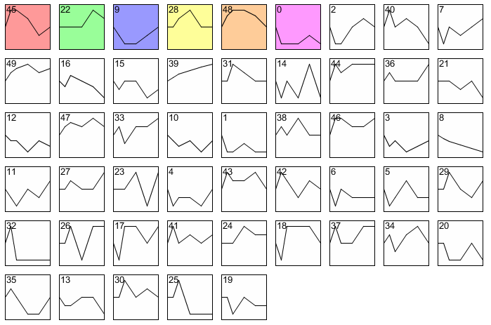
wt all STEM profiles

Slide 3
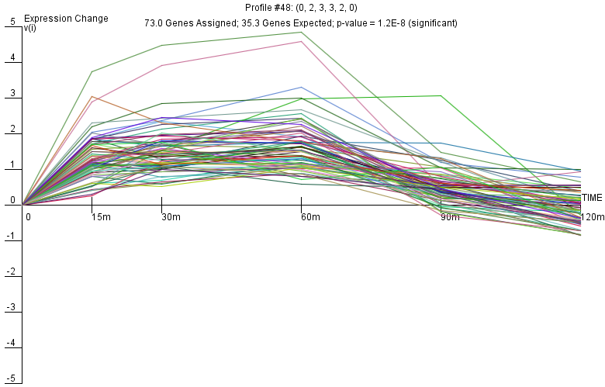
wt Profile 48

Slide 4
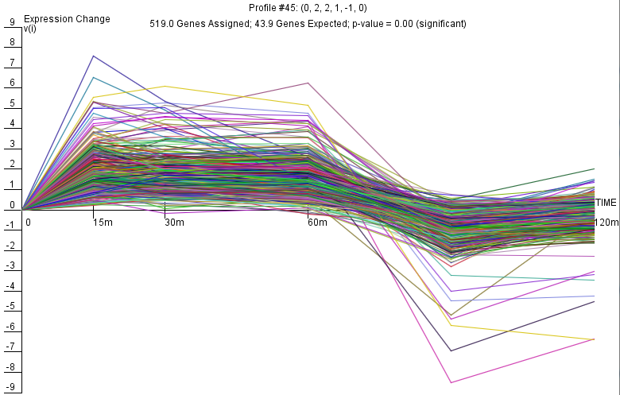
wt Profile 45

Slide 5
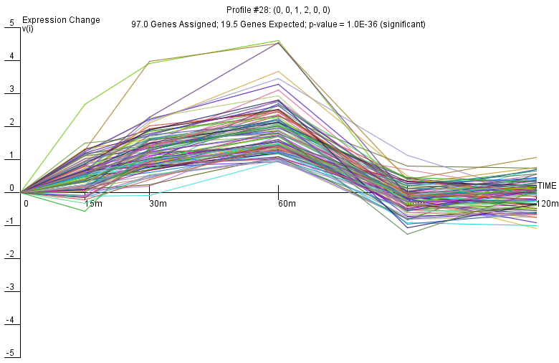
wt Profile 28

Slide 6
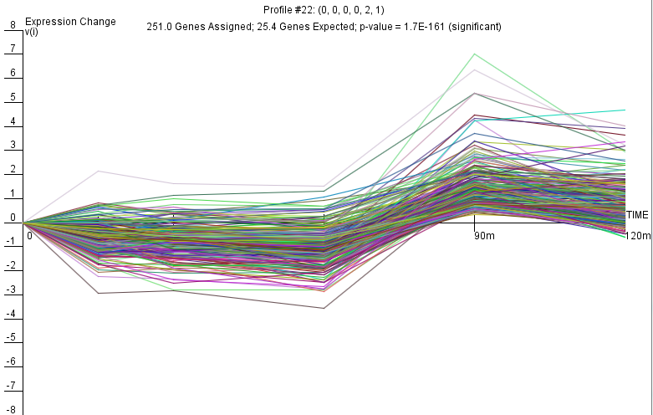
wt Profile 22

Slide 7
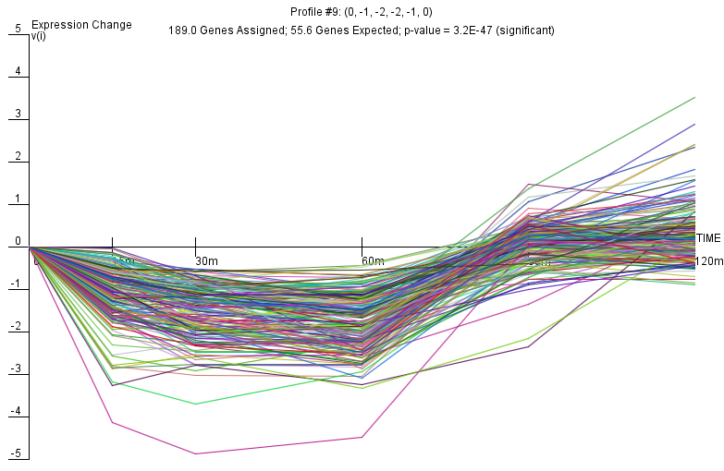
wt Profile 9

Slide 8
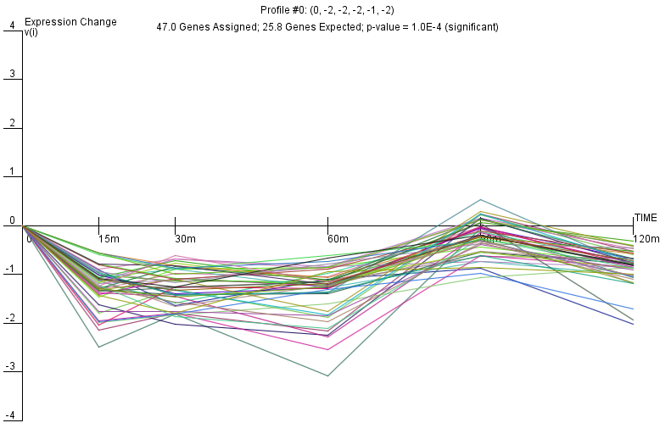
wt Profile 0

